Slide 1
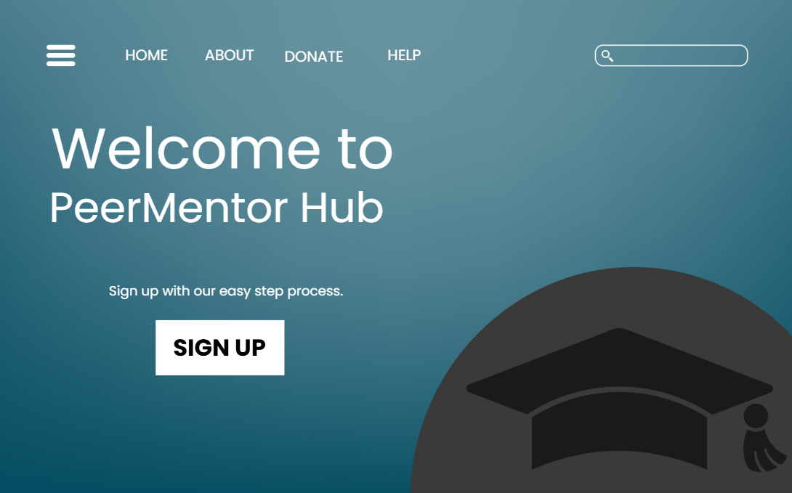
This design with a navigation bar aligns well with the top of the page. Since many websites do this, it makes it easier for the user to understand and use the website.
I would move the text box slightly to the left and put the settings and profile icon on the right for consistency. I would repeat this throughout all the web pages for repetition.
Iconic Representation
Symbols instead of words
Five Hat Racks
Popular layout. Sorting by ranking, improving user experience.
Signal –to-noise-ratio has been used throughout. Enhances usability & reduces cognitive load.
Ockham’s Razor
Simple minimal design throughout including simple relatable logo.
Hicks Law
Simple & limiting options to the most important ones.
By Cigdem Onay

Slide 2
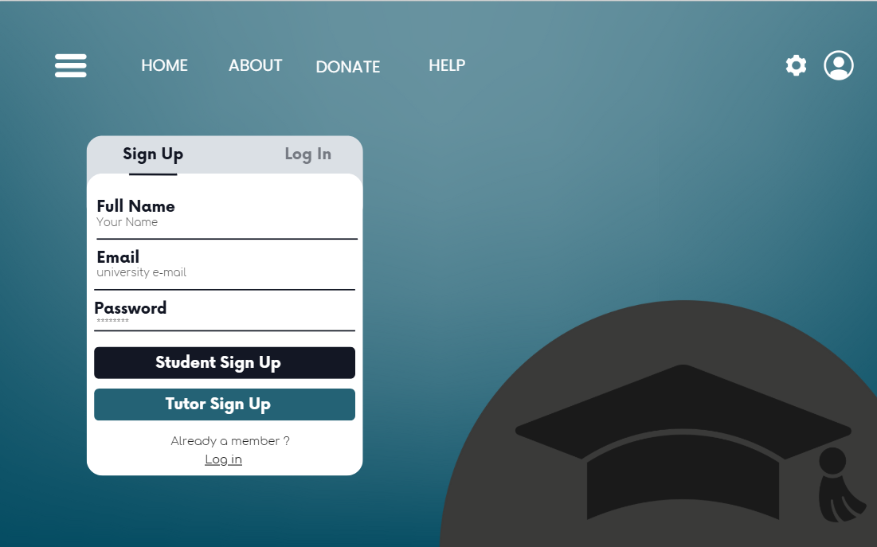
The simplicity, user –friendly ease of use and clutter free theme is carried on throughout the website. This makes the platform compatible with mobile use and reduces decision time. Golden Ratio rule for layout has been used to make website pleasing to the eye.
Iconic Representation
Symbols instead of words
By Cigdem Onay

Slide 3
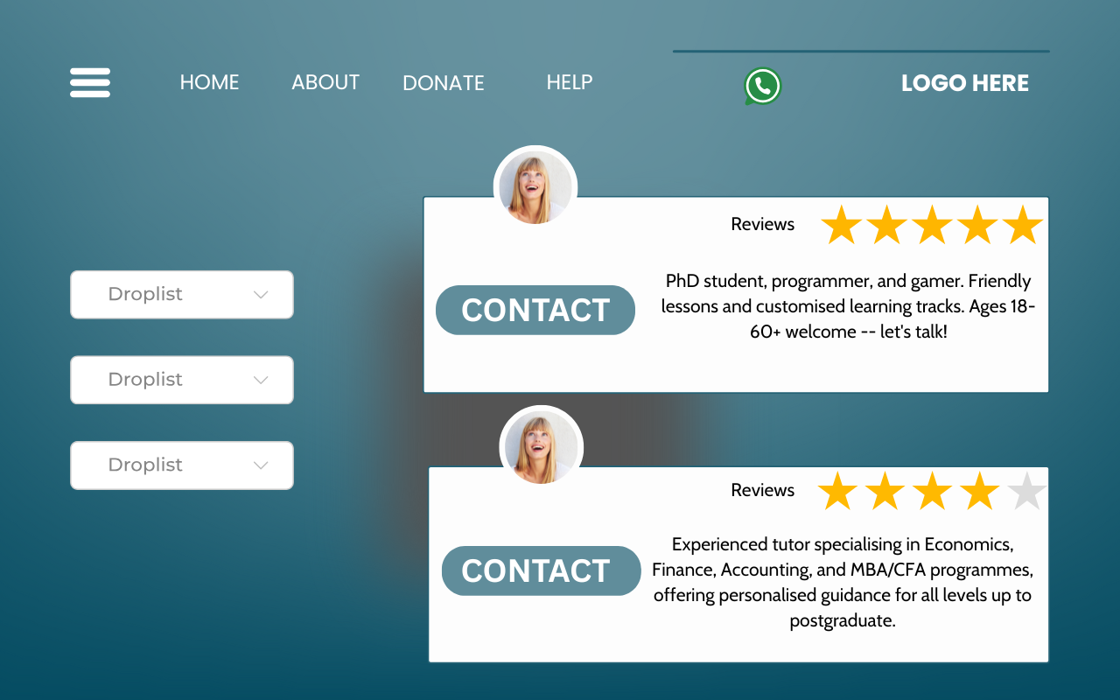

Every button is accessible via the keyboard to meet accessibility and usability requirements and to create a better user experience. All button names and text match with real-world terms. For all images I put in my document, I would ensure they comply with the rule of thirds and the golden ratio.
I would move the logo to the left of the screen as that’s where most logo’s are displayed. I would do this for every page for consistency so the user can quickly recognise the design and know how to use the website.
Easy to recognise review system.
Summary of tutor, experience/ expertise.
I would move the what’sapp button to the bottom of the screen as that’s where most social media buttons are placed which makes it more recognisable to the user.
Simple Button to view calendar for availability and contact info.

Slide 4
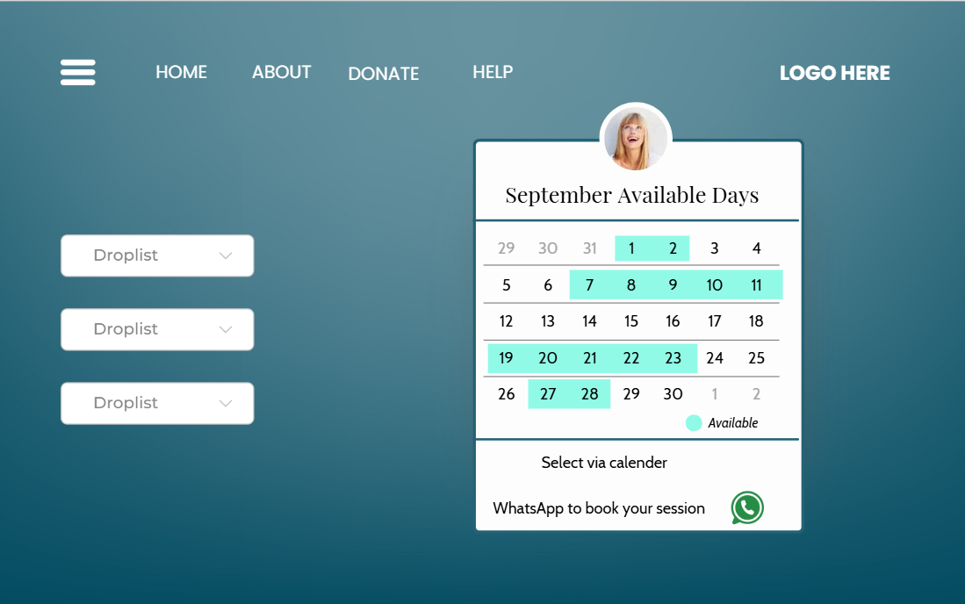

The amount of text shown is minimal and only shows necessary content which meets the signal to noise design principle.
Progressive Disclosure
Most important information first and reveal more details as needed. Keeps interface clean and simple.
A simple small logo for high populated information/function pages.
Five Hat Racks
This dropdown list can be used for filtering;
Subject
Level
Price – from low to high
Integrated booking calendar system for tutor/mentor. Highly visible simple colour coded availability indicator.
Free budget friendly app link to solve users wants. Real time text/call/video.
By Cigdem Onay

Slide 5
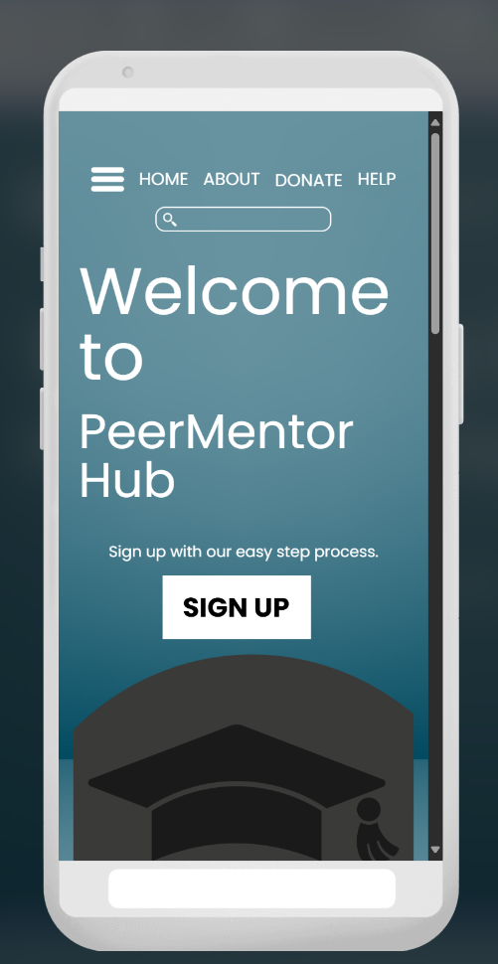
Successful easy to access home page.

Slide 6
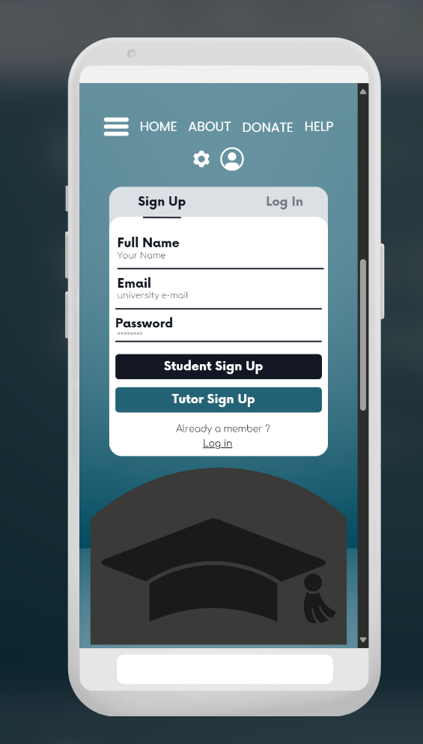
The sign-up page and access is successful with simple form.

Slide 7
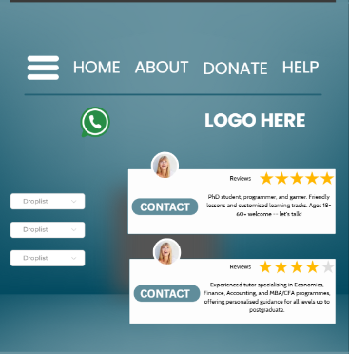

The buttons are too large for the other text on the screen and there are scalability issues between screen sizes which need to be addressed.
Although a good layout, this page needs to be further developed for full screen experience as it was displayed stretched to half a page.

Slide 8
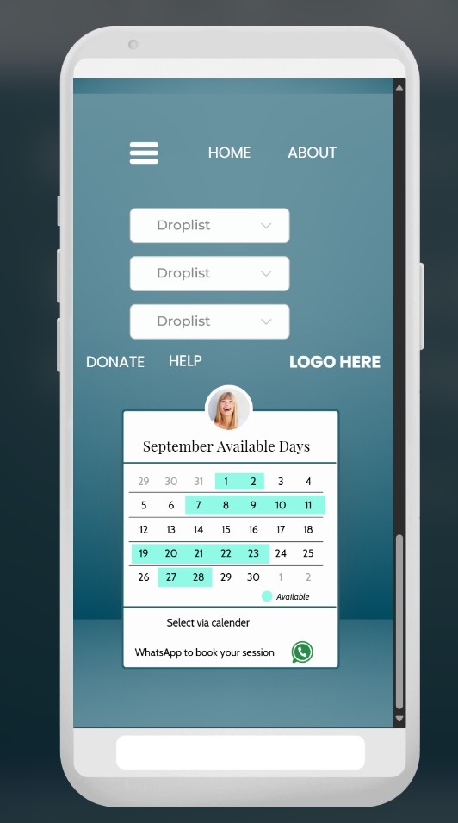
There are buttons in the wrong place. Some are at the top, some are in the middle which is not appealing to the user and is confusing.
This page needs to be further developed as font sizes hasn’t adapted to mobile version and layout has been misaligned.
In future, I would ensure the designs are compatible and scalable to different screen sizes.

